Slide 1
Android App Development
Dr. Selvaraaju Murugesan
selva@forgeforward.in

Slide 2
Internet of Things
Apps are the tools to offer services to end customer
Customers interact with Apps
Apps Store | Apps Count
iOS App Store | 1.5 million
Play Store | 1.6 million
Windows Store | 0.5 million
Courtesy: http://www.statista.com/statistics/266488/forecast-of-mobile-app-downloads/

Slide 3
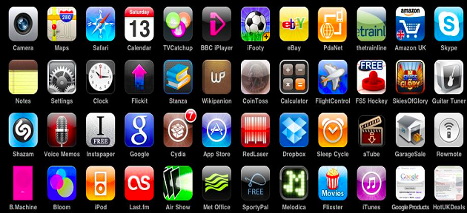
App World is getting flooded !

Slide 4
We Consume...
Average time spent in Apps worldwide is 45 minutes !
Mostly social media and gaming apps
Less than 4 minutes in Productivity Apps
Huge Challenges for delivering IoT Services
Courtesy: Nielsen

Slide 5
Challenges
Native Apps
HTML
Javascript
Web frameworks
Mobile Apps
Own SDK
No Standard Programming Language
UX / UI
Free / Freemium / Paid

Slide 6
Future of Apps ?
Motivation of Apps
To save our time and increase comfort
Not spent so much time in Apps
Best Apps are preempts your needs and serves you information
OMG ! What about my privacy ?
App Streaming / App Linking
Apps will be ubiquitous

Slide 7
Let’s build Apps
WiFi
SSID : BOLT
Password : FORGE958
MIT APP Inventor 2
http://ai2.appinventor.mit.edu
QR Scanner App
Download any QR Scanner App from Play store
Program Materials
https://github.com/selvaraaju
Choose Android_App_Development repo to download code and presentation

Slide 8
Program 1
Designer / Block / Palette
Create a grocery list
Checkbox
Button
Notifier
Build -> App (Provide QR code for App)
Scan the QR code using QR Code Scanner App
Open the url to download .apk file and install the App in your phone

Slide 9
Program 2 : Camera & Video player
Use camera to shoot picture and video
Components
2 buttons
Canvas
Videoplayer
Create a grocery list
Checkbox
Button
Notifier
Build -> App (Provide QR code for App)
Scan the QR code using QR Code Scanner App
Open the url to download .apk file and install the App in your phone

Slide 10
Program 3 : Text to Speech and Speech to Text
App should speak the sentences written in textbox and it also should recognise some text which is spoken to it
Components
2 buttons
3 labels
1 textbox
1 TextToSpeech
1 SpeechRecogniser
1 Notifier
Build -> App (Provide QR code for App)
Scan the QR code using QR Code Scanner App
Open the url to download .apk file and install the App in your phone

Slide 11
Program 4 : Send SMS
App should send SMS.
Components
1 Texting (Social Tab)
2 TextBox and 2 Labs
1 Button
You should enter text message and phone number.
Clicking on the button should send SMS
Build -> App (Provide QR code for App)
Scan the QR code using QR Code Scanner App
Open the url to download .apk file and install the App in your phone

Slide 12
Program 5 : Sensors
App should show readings of Accelerometer
Components
1 Accelerometer (Sensors tab)
Choose labels as necessary
You should see the X, Y & Z values of accelerometer
Build -> App (Provide QR code for App)
Scan the QR code using QR Code Scanner App
Open the url to download .apk file and install the App in your phone

Slide 13
Additional Programs : GPS
Use LocationSensor (Sensors Tab) to display latitude, longitude and address of your current location
Make sure turn on “Location” settings in your smartphone
Tip 1: You should enable “LocationSensor”
Tip 2: Set ProvideName to “gps”
Tip 3: You should set DistanceInterval to 5
Tip 4: Use timer to update the atitude, longitude and address of your current location

Slide 14
Program 6 : Home Automation
App should communicate with Arduino over WiFi
Components
2 Buttons
2 Web (Connectivity Tab)
Send a GET request to turn on / off the light
Build -> App (Provide QR code for App)
Scan the QR code using QR Code Scanner App
Open the url to download .apk file and install the App in your phone

Slide 15
Program 7 : HC-05 Bluetooth Module
HC-05 Bluetooth module is configured as “Slave” mode and will communicate over serial protocol
AT commands to configure HC-05 module
Arduino is configured to read from HC-05 via serial protocol
Send colors names such as red, green, yellow via serial protocol
DEMO

Slide 16
Thank You

